Slide 1

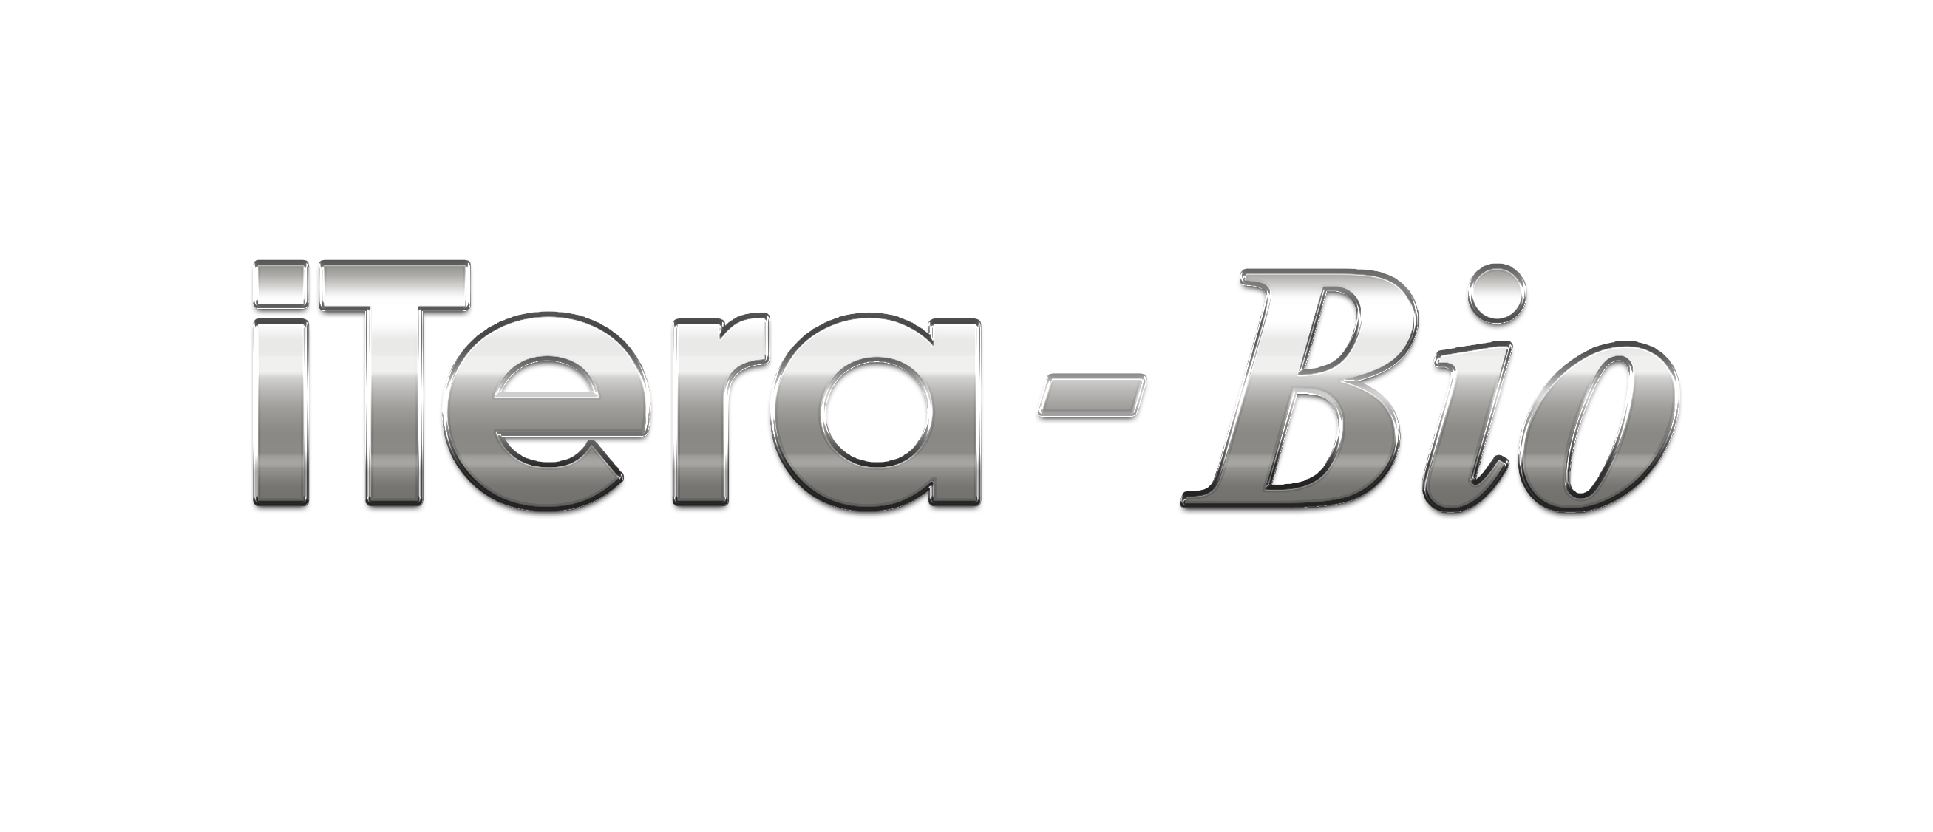


Slide 2

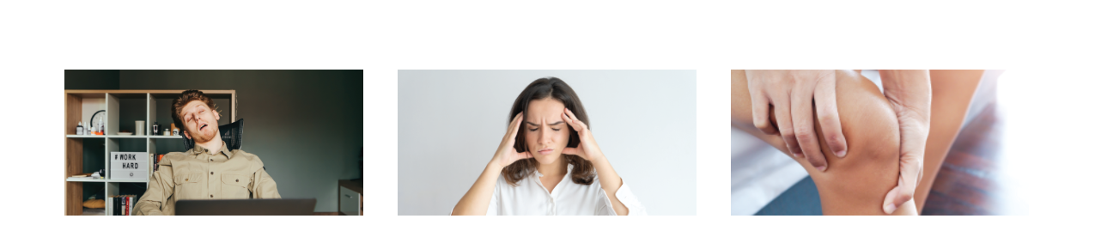
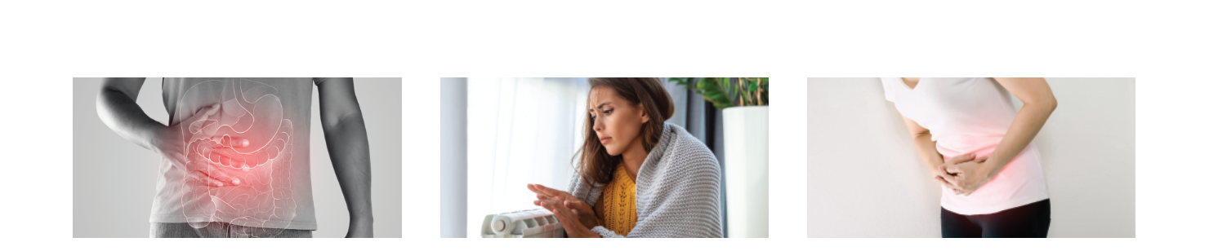
70% of population are suffering from sub-health status :
Fatigue, anxiety, headache dizziness
Inability to concentrate,
memory loss
Gout, body feeling heaviness
Bloating, abdominal pain, indigestion, constipation
Low body temperature,
fatigue
Irregular menstruation

Slide 3
The Principle of Sickness in Traditional Chinese Medicine
Deficiency leads to cold, cold → dampness, dampness → condensation, condensation → blood stasis, blood stasis → blockage, blockage → tumor, tumor → cancer.
Conclusion: Severe sickness is the accumulation of ailments
• Deficiency → Tired, lack of energy, sleepy
• Cold → Afraid of cold, feeling cold at night
• Wet → As if they are wearing clothes that have been soaked in the rain, body feel heavy and uncomfortable
• Congealing → The body is prone to soreness and pain
• Stasis → body aches and numbness, swelling pain and mixed body
discomfort. Malignant tumors are prone to mutate to cancer
• Cancer → Cancer is terrible, it may be too late

Slide 4
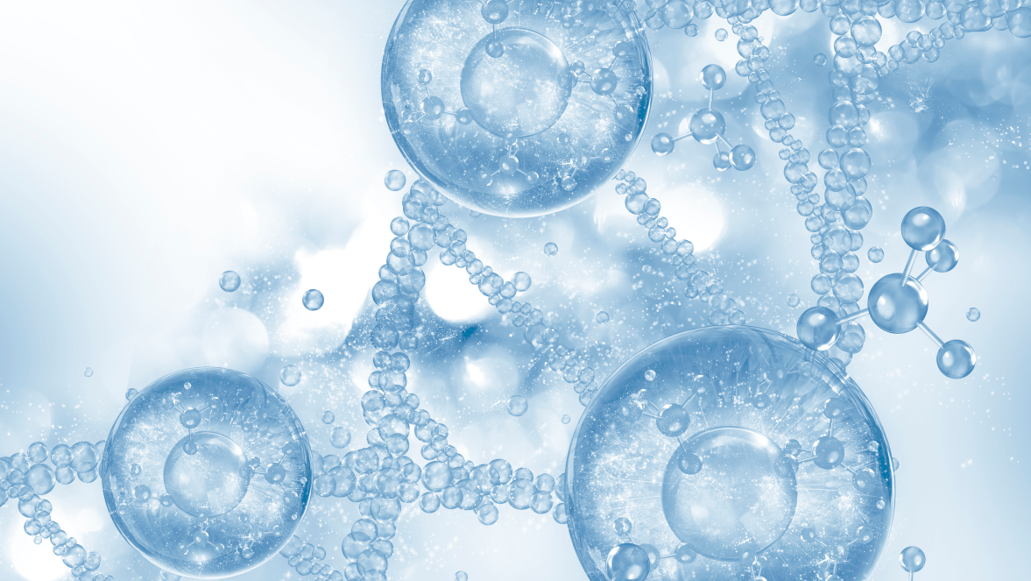
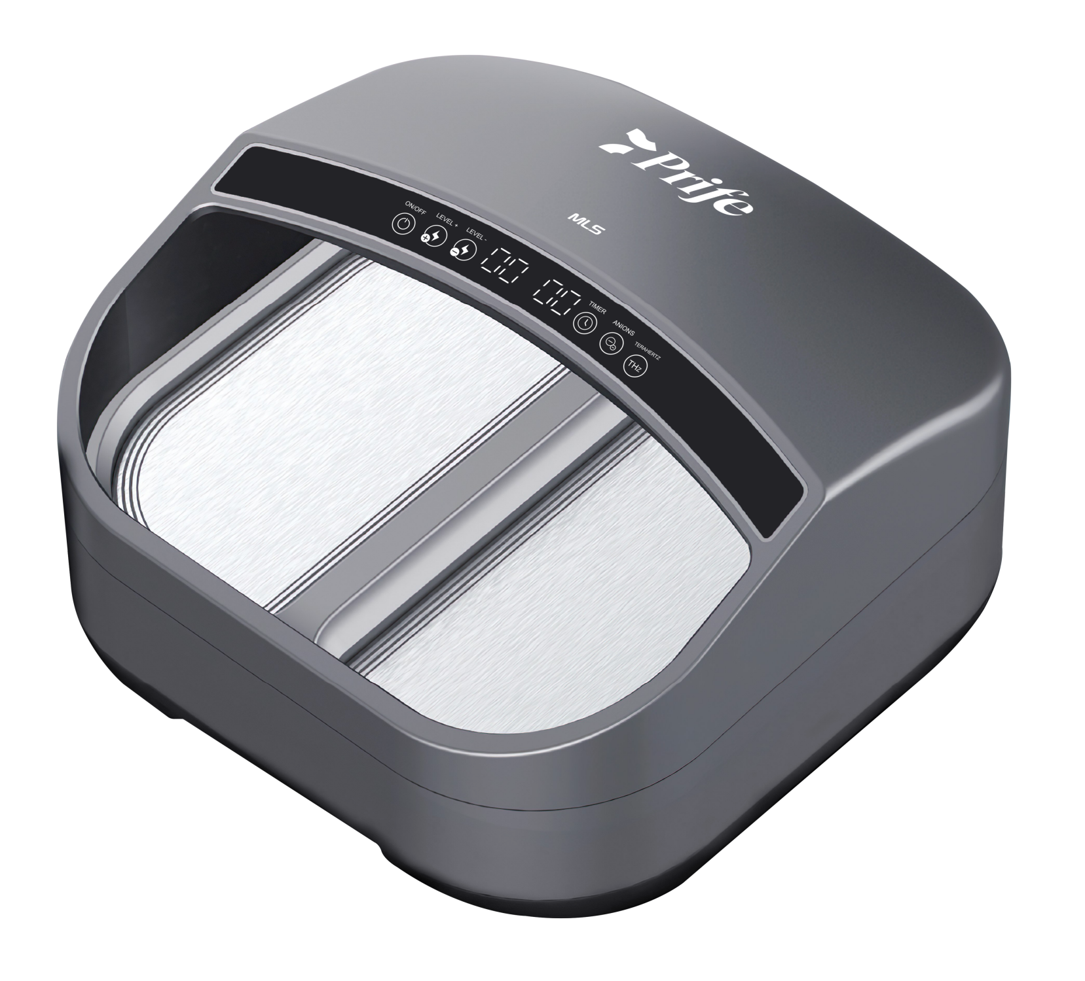
iTera-Bio - Upgraded Version
Activates the cellular energy
Dispels cold and dampness
Promotes metabolism
Cells activation
Purifies the body
Promotes circulation
Body shaping & anti-aging
Diathermy fat burner
Relieves inflammation

Slide 5
3 Core Technologies
Energy 1
Terahertz waves accurately detect cell abnormalities in human cells through spectral imaging. The energy will eliminate the abnormal or mutated cells and revive the inactive cells.
Energy 2
Negative ions are known as air vitamins, besides purifying the air, it also helps cleanse the blood vessel to prevent arteriosclerosis, enhances immune function, anti-oxidant, reduces stress and anxiety, improves sleep quality, reduces allergies and asthma symptoms.
*A negative ion concentration of more than 10,000/cm³ can enhance the healing ability of the human body. iTera-Bio releases 10,000,000/cm³ of negative ions
Energy 3
Graphene far-infrared ray rapidly increases the temperature of the skin surface, accelerates blood circulation, relieves muscle tension and relieves pain
Triple Energy for Better Effect

Slide 6
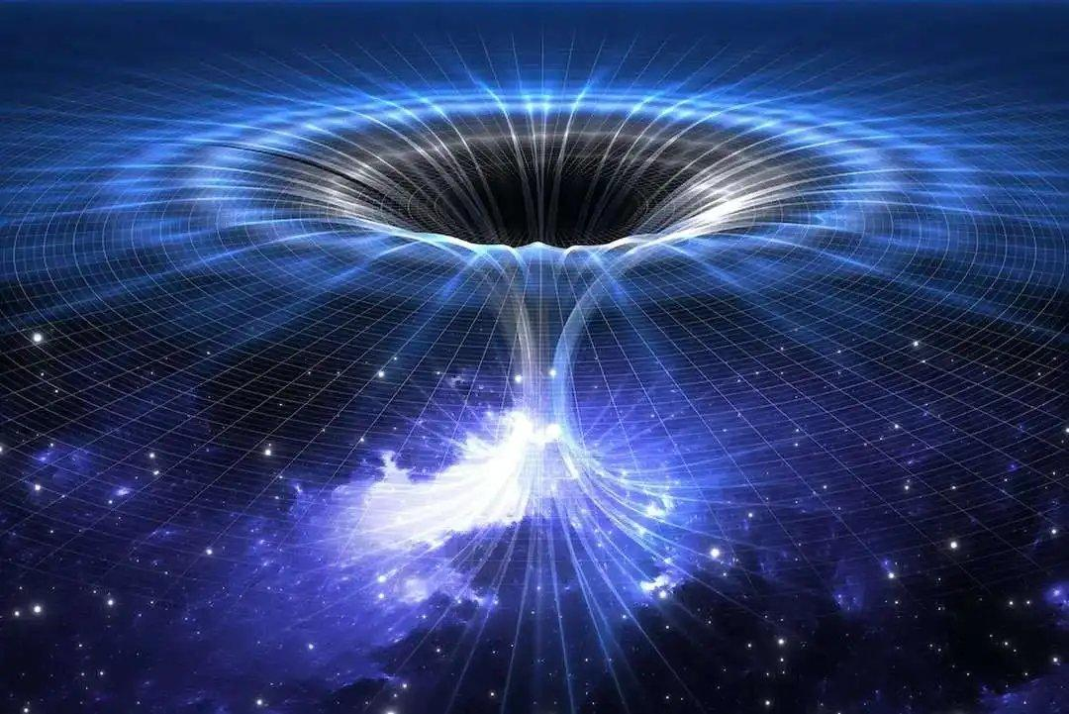
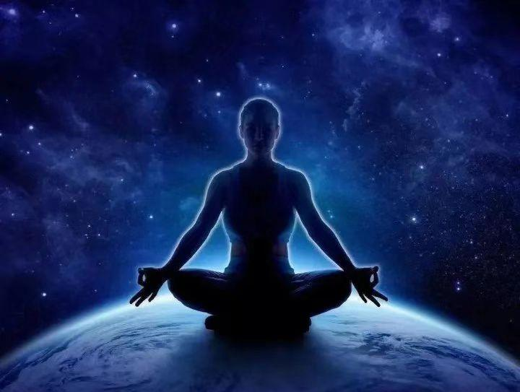
RESONANCE
Resonance means two or more objects vibrate together at the same frequency. Resonance is happened when one object vibrates, the other object(s) with similar frequency follow.

Slide 7
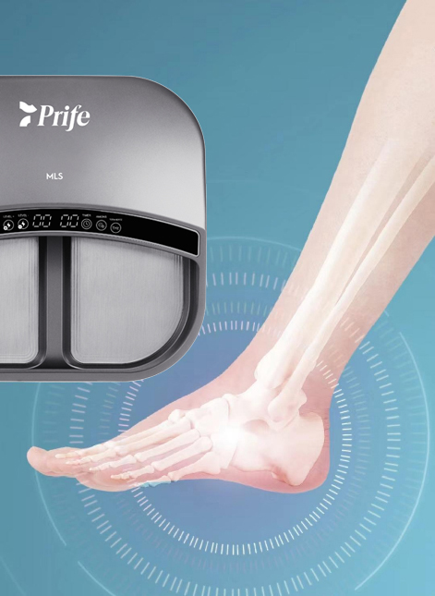
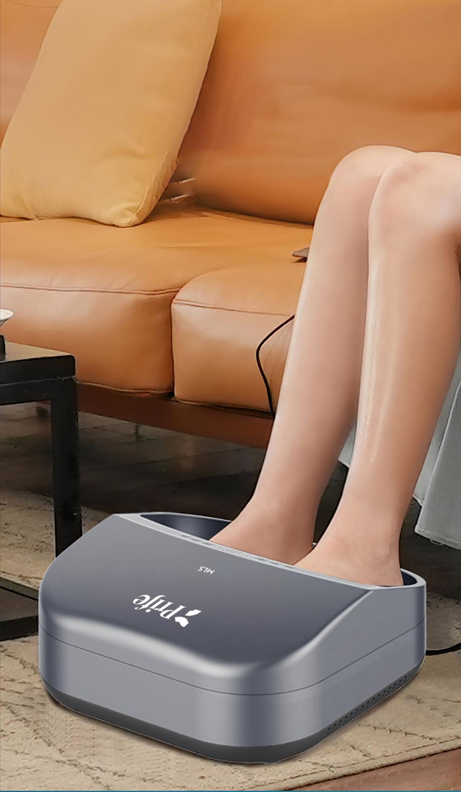
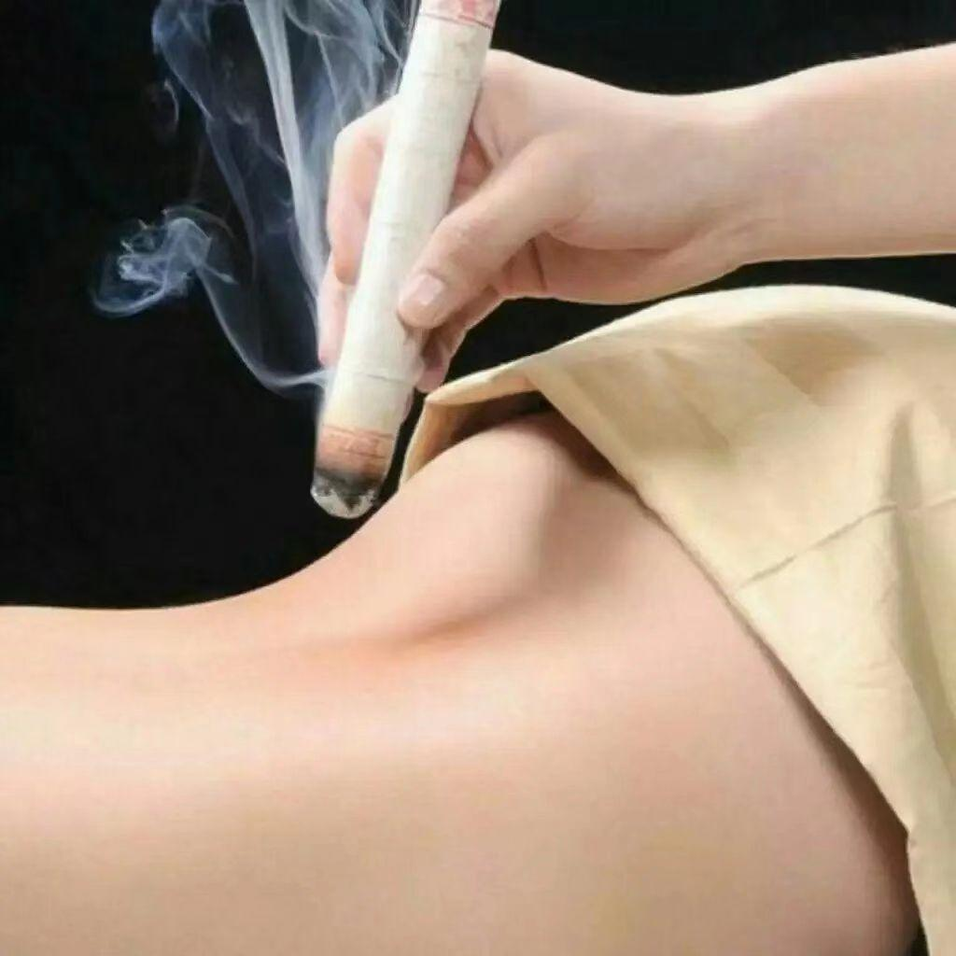
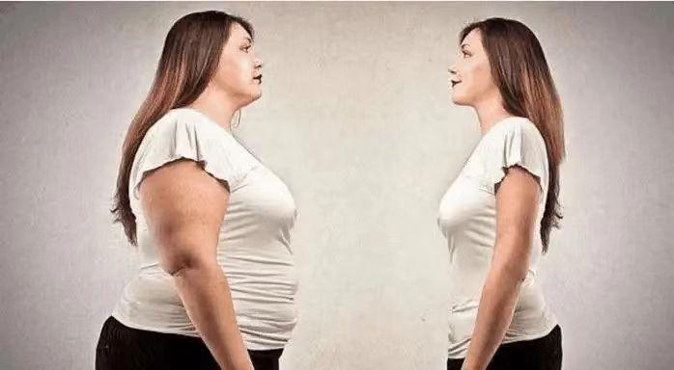
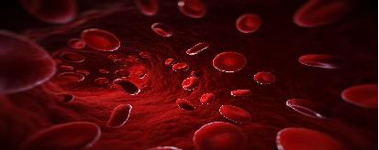
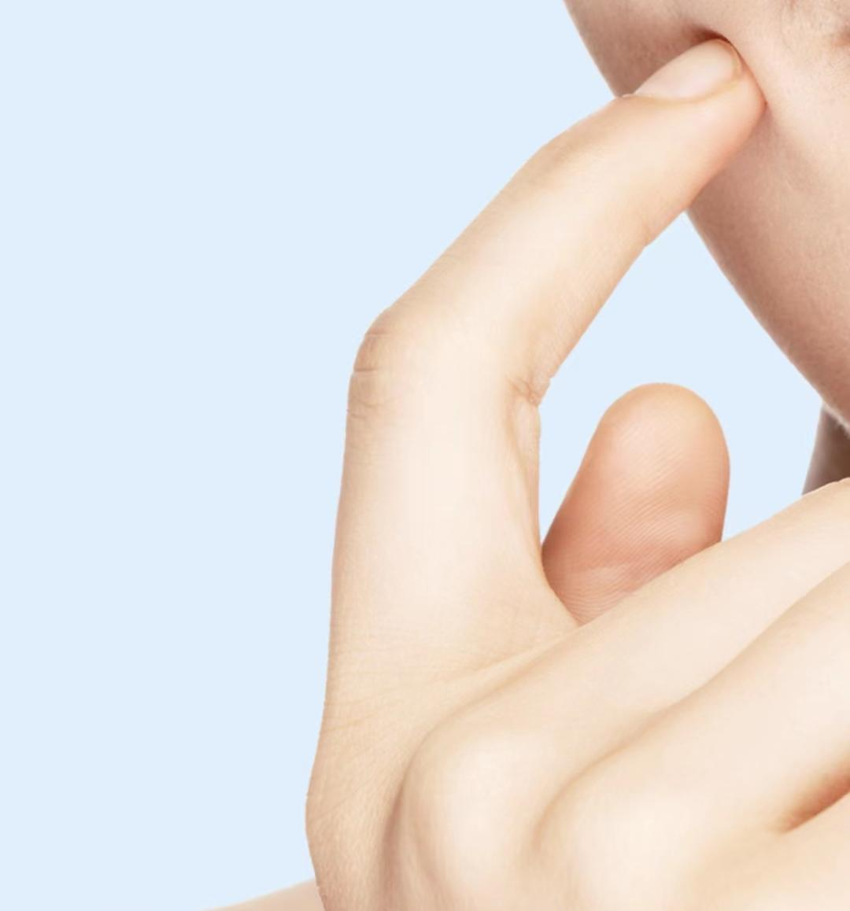
MAIN FUNCTIONS
Anti-
bacteria
Warming
Dispelling
Anti bacteria & wellness
Far-infrared ray
Dispels cold & dampness,
relieves inflammation
Reducing
Purifying
Beautifying
Fat burning & body shaping
Purifies the body
Beauty & anti-aging

Slide 8
Anti Bacteria & Wellness
Tens of millions of negative ions
ANTI-BACTERIA
Deodorization & sterilization :
Odor, fungal infection, athlete's foot, sweaty feet...
“SPA”In-depth
from foot to
entire body !

Slide 9
Far-infrared Ray
Graphene far infrared can penetrate 3-4 cm under the skin and is easily absorbed by tissues
1. Rapidly increase the surface temperature and
accelerate the subcutaneous blood circulation;
2. Relieves muscle tension, relieves pain, and regulates
autonomic nerves;
3. Increase metabolism, enzyme activity, and promotes
vasodilation;
4. microvascular permeability, helps discharge waste,
accelerates wound healing;
5. Increases muscle contraction ability, relieves pain
and muscle spasm;
6. Reduces blood viscosity and reduces stiffness and
discomfort!
WARMING
No need to worry about cold weather!

Slide 10
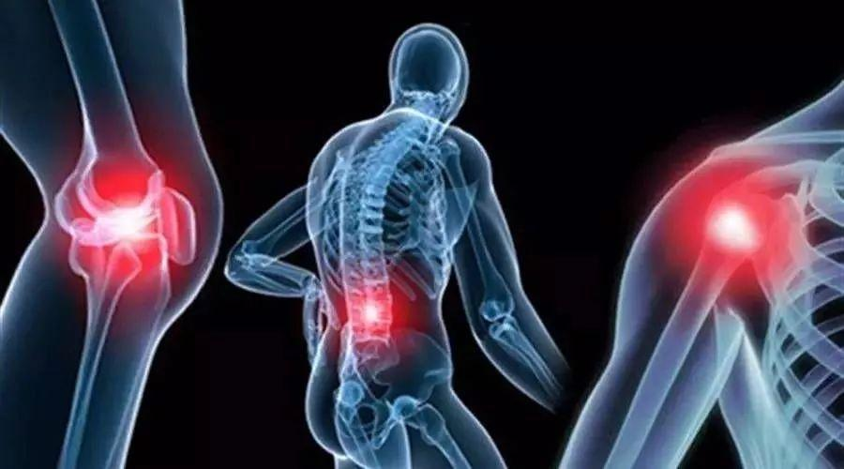
Dispels Cold & Dampness,
Relieves Inflammation
DISPELLING
（1）Increase the number of white blood cells to enhance its sterilization ability and anti-inflammatory effect. When injected into the nerve, it numbs the nerve and relieves various types of pain caused by excessive nerve tension.
（2）It dilates blood vessels, reduces blood flow resistance and blood viscosity, improves microcirculation, increases the ability of oxygen storage and carbon dioxide elimination to allow the transportation of nutrition to the whole body. As such, our organ functions and immune system can be restored at optimum level, it therefore reduces our chances of getting diseases.

Slide 11
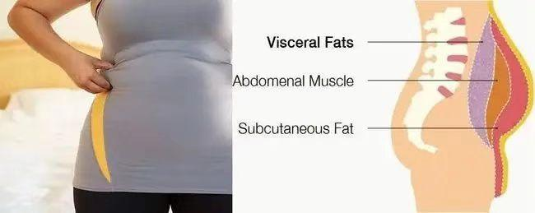
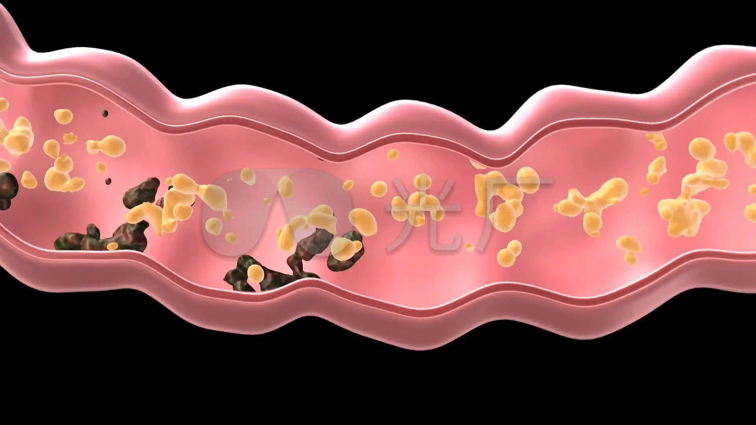
Fat Burning & Body Shaping
( 1 ) It acts on motor nerves, encourages the rhythmic contractions and relax of muscles to accelerate blood circulation and nutrient metabolism processes of muscle tissues.
( 2 ) To improve muscle strength, prevent muscle atrophy, promote nerve regeneration, and transmit impulses to the central nervous system at the same time getting refreshed, energized and not exhausted.
( 3 ) It decomposes extra fat cells in the body, eliminates toxins, helps body fight and eliminate the hazardous free radical and look younger.
( 4 ) Nourishes the spleen and stomach, reconciles qi and blood, creates a virtuous circulation in the body, decomposes extra fat, and restores normal metabolic function
REDUCING

Slide 12
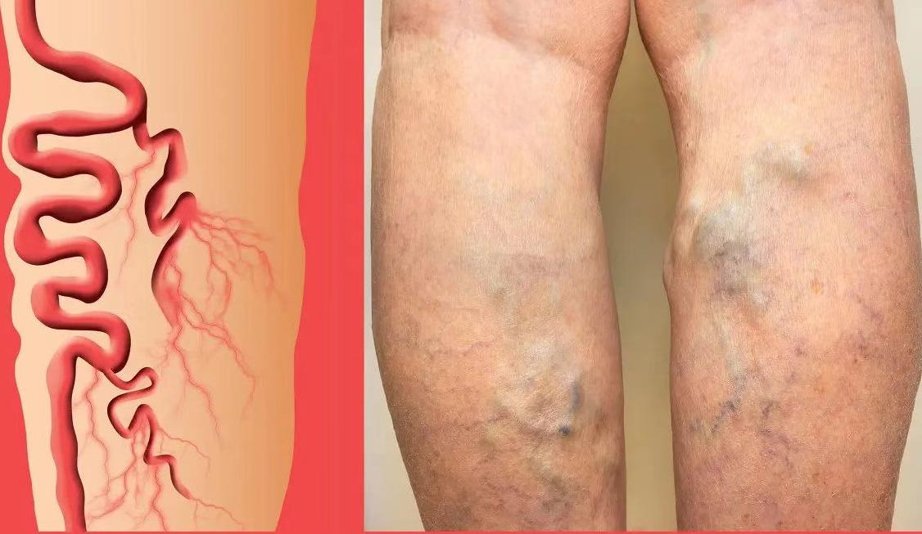
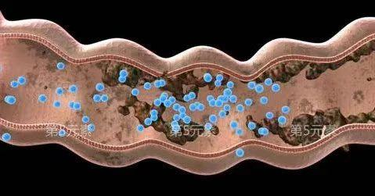
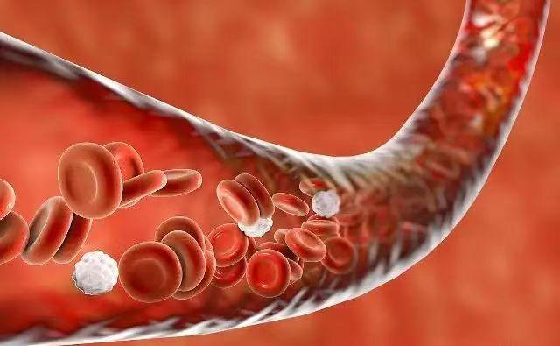
Purifies The Body
（1）It accelerates blood circulation, rapidly metabolizes and eliminates acidic substances in the body, alkalizes the blood, catabolizes cholesterol, triglycerides and other substances adhered to the blood vessel wall, and improves the internal environment;
PURIFYING
Clearing stasis & blockage
Detoxifies colon
Fat burning
Eliminates toxins

Slide 13
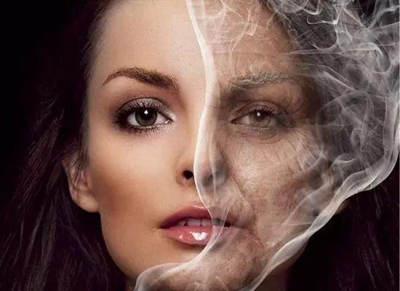
Beauty & Anti-aging
( 1 ) Removes Freckle & wrinkle, removes dark circles
& eye bags.
( 2 ) Skin becomes more radiant and elastic.
( 3 ) Skin becomes lighter, moist and rosy.
( 4 ) Detoxification, accelerating metabolism, activating blood & cells, regulates body from inside out
BEAUTIFYING
The Bio energies can activate cell vitality, stimulate collagen regeneration, delay skin aging and smoothes wrinkles!

Slide 14
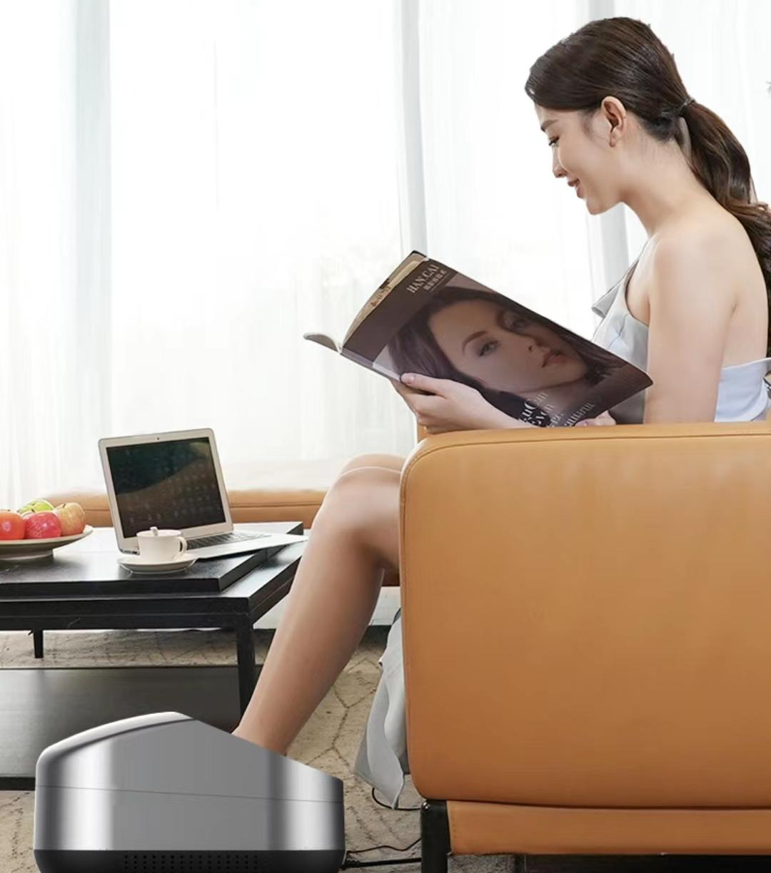
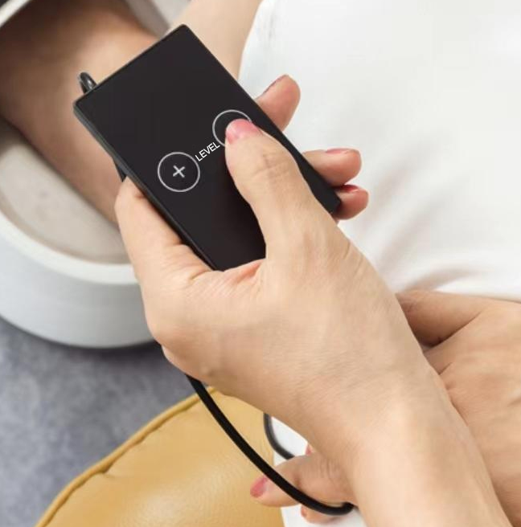
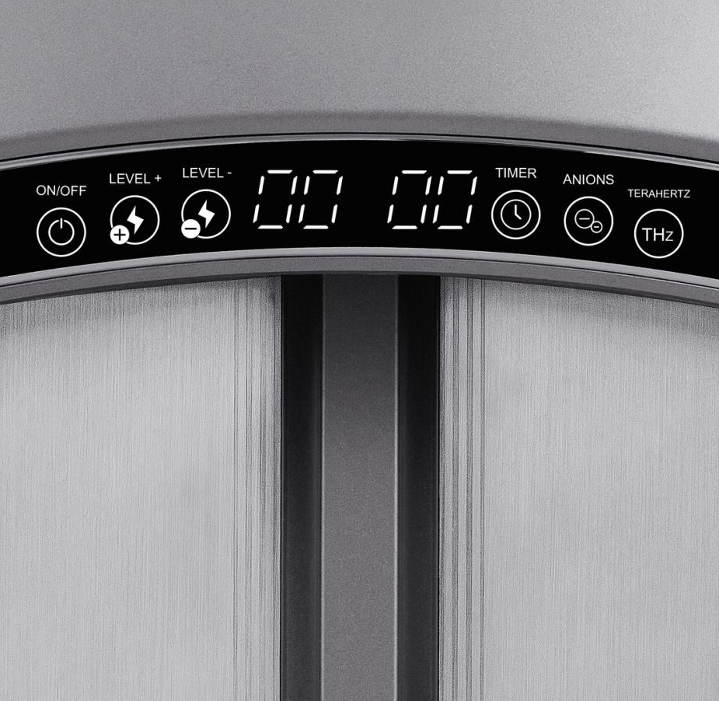
High End & Core Technology
Self-start detection
Breakpoint memory, easy to continue
IMD
（In-Mold-Decoration)

Slide 15
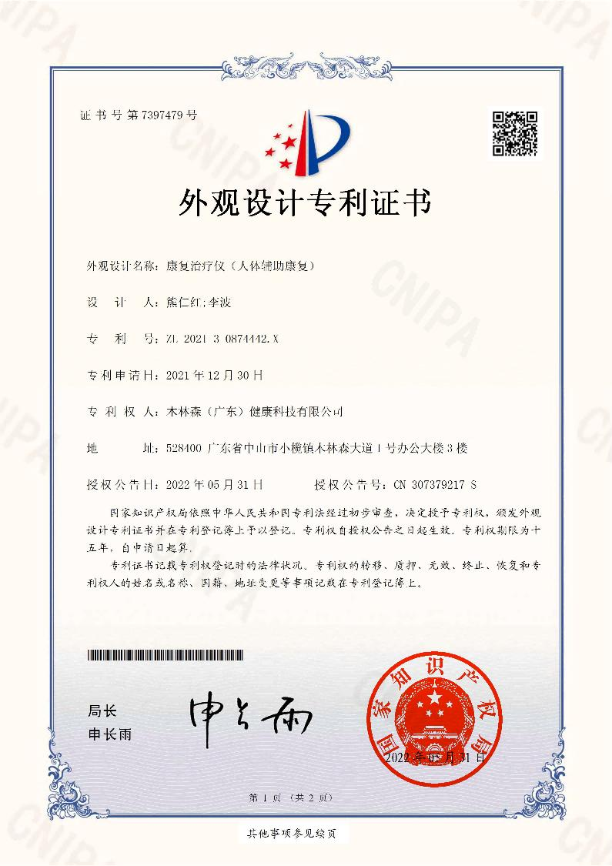
UNIQUE PATENTS
Patent Code
Patent Names
Patent Type
2022219481639
An ergonomic health care equipment
utility model
2022218905592
A pedicure device with good waterproof performance
utility model
2022223178390
A pedicure device with negative ion deodorizing function
utility model
2022223033813
A kind of support and stable health equipment
utility model
2022222432233
A kind of pedicure equipment with graphene heating device
utility model
2022221384266
A micro-current foot therapy device with good insulation performance
utility model
An ergonomic health care equipment
A pedicure device with good waterproof performance
A pedicure device with negative ion deodorizing function
A kind of support and stable health equipment
A kind of pedicure equipment with graphene heating device
A micro-current foot therapy device with good insulation performance

Slide 16
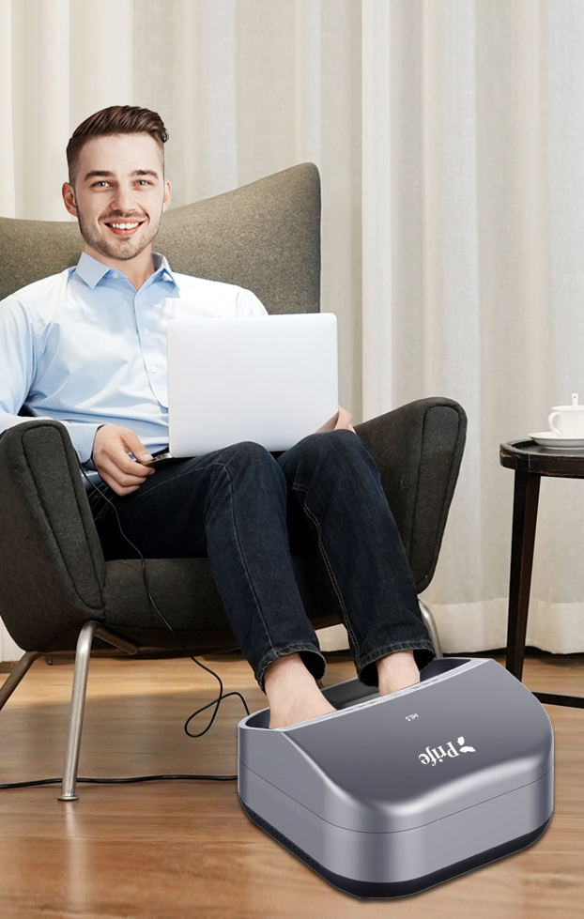

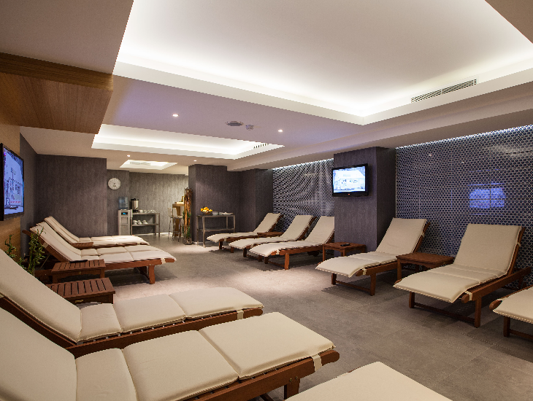
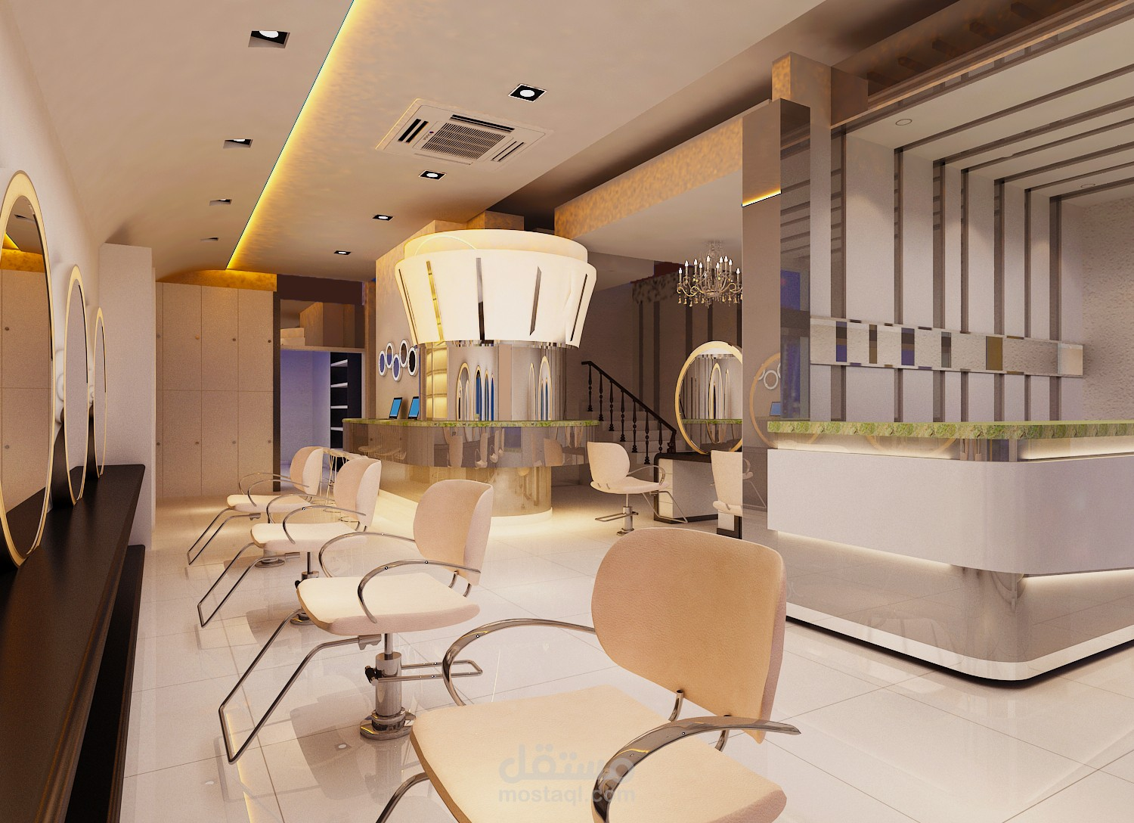
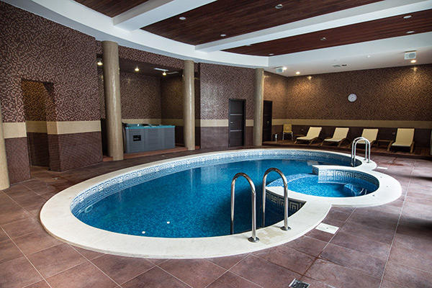
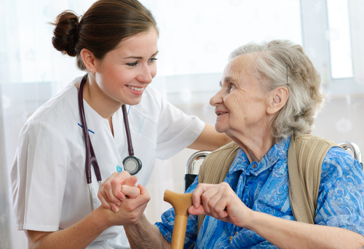
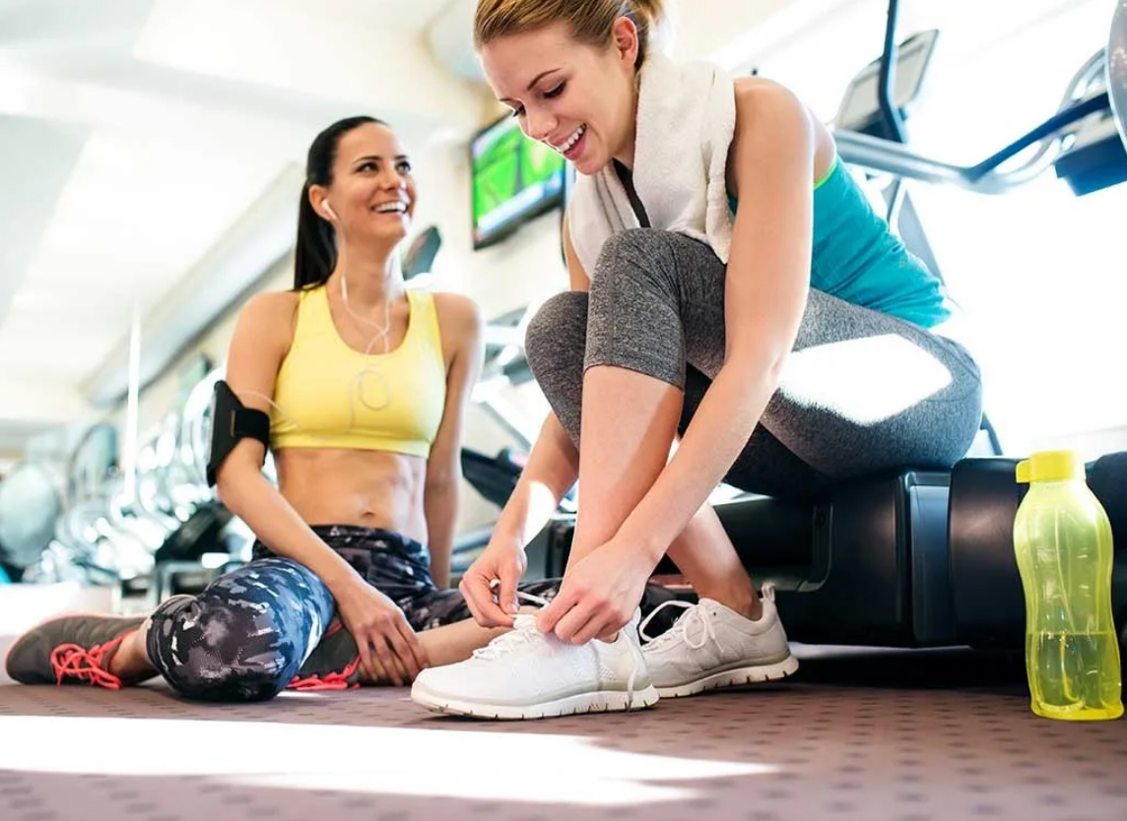
Who Need
It Most?
Suitable
For
Cold & dampness body condition
Office worker
Postpartum mother
Obese people
Beauty lovers
Middle-aged and elderly people
Sitting or standing for a long time
Person with hypertension, high cholesterol & high blood sugar
Home use
Therapy centre Beauty salon
SPA centre
Rehabilitation centre
Activity centre
Office
Home use
Therapy centre
Beauty salon
SPA centre
Rehabilitation centre
Activity centre

Slide 17
THANK YOU !

